Slide 1
CH10 Buffer Overflow
Zonghua Gu
2018, ZJU
Notes:
This chapter provides an overview of computer security. We begin with a discussion
of what we mean by computer security. In essence, computer security deals
with computer-related assets that are subject to a variety of threats and for which
various measures are taken to protect those assets. Accordingly, the next section of
this chapter provides a brief overview of the categories of computer-related assets
that users and system managers wish to preserve and protect, and a look at the
various threats and attacks that can be made on those assets. Then, we survey the
measures that can be taken to deal with such threats and attacks. This we do from
three different viewpoints, in Sections 1.3 through 1.5. We then lay out in general
terms a computer security strategy.
The focus of this chapter, and indeed this book, is on three fundamental
questions:
1. What assets do we need to protect?
2. How are those assets threatened?
3. What can we do to counter those threats?

Slide 2
Outline
Introduction
Stack overflows
Defending against buffer overflows
Compile-time defenses
Run-time defenses
Other forms of overflow attacks
Heap overflows
Global data area overflows
Integer overflows
Notes:
Stack overflows
Buffer overflow basics
Stack buffer overflows
Shellcode
Defending against buffer overflows
Compile-time defenses
Run-time defenses
Other forms of overflow attacks
Replacement stack frame
Return to system call
Heap overflows
Global data area overflows
Other types of overflows

Slide 3
Introduction to Buffer Overflow
NIST Definition:
“A condition at an interface under which more input can be placed into a buffer or data holding area than the capacity allocated, overwriting other information. Attackers exploit such a condition to crash a system or to insert specially crafted code that allows them to gain control of the system.”
A very common attack mechanism
First used by the Morris Worm in 1988
Still of major concern
Buggy legacy code in widely deployed OSes and applications
Careless programming practices
Notes:
A buffer overflow , also known as a buffer overrun , is defined in the NIST Glossary
of Key Information Security Terms as follows:
Buffer Overrun A condition at an interface under which more input can be
placed into a buffer or data holding area than the capacity allocated, overwriting
other information. Attackers exploit such a condition to crash a system or to
insert specially crafted code that allows them to gain control of the system.
We begin with an introduction to the basics of buffer overflow. Then we
present details of the classic stack buffer overflow. This includes a discussion of
how functions store their local variables on the stack and the consequence of
attempting to store more data in them than there is space available. We continue
with an overview of the purpose and design of shellcode, which is the custom code
injected by an attacker and to which control is transferred as a result of the buffer
overflow.
Next we consider ways of defending against buffer overflow attacks. We start
with the obvious approach of preventing them by not writing code that is vulnerable
to buffer overflows in the first place. However, given the large, existing body
of buggy code, we also need to consider hardware and software mechanisms that
can detect and thwart buffer overflow attacks. These include mechanisms to protect
executable address space, techniques to detect stack modifications, and approaches
that randomize the address space layout to hinder successful execution of these
attacks.
Finally, we briefly survey some of the other overflow techniques, including
return to system call and heap overflows, and mention defenses against these.

Slide 4
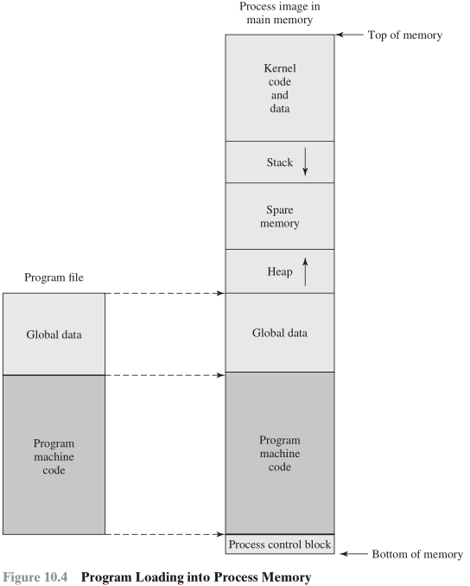
Buffer Overflow Basics
When a process attempts to store data beyond the limits of a fixed-sized buffer, it may overwrite adjacent memory locations that hold data or instruction.
Buffer could be located on the stack, in the heap, or in the global data section of the process
Consequences:
Program data corruption
Unexpected transfer of control
Memory access violations
Execution of code chosen by attacker
4
Notes:
Occur when buffer is located on the stack
Also referred to as stack smashing
Stacks are used
In function calls
For allocation of memory in the stack frame for
Local variables
Parameters
Return address
Stack overflow consequences:
Corruption of program data
Memory access violations
Transfer of control to execute malicious code
A buffer overflow can occur as a result of a programming error when a process
attempts to store data beyond the limits of a fixed-sized buffer and consequently
overwrites adjacent memory locations. These locations could hold other program
variables or parameters or program control flow data such as return addresses and
pointers to previous stack frames. The buffer could be located on the stack, in the
heap, or in the data section of the process. The consequences of this error include
corruption of data used by the program, unexpected transfer of control in the program,
possibly memory access violations, and very likely eventual program termination.
When done deliberately as part of an attack on a system, the transfer of control
could be to code of the attacker’s choosing, resulting in the ability to execute arbitrary
code with the privileges of the attacked process.
A stack buffer overflow occurs when the targeted buffer is located on the stack, usually
as a local variable in a function’s stack frame. This form of attack is also referred to
as stack smashing . Stack buffer overflow attacks have been exploited since first being
seen in the wild in the Morris Internet Worm in 1988. The exploits it used included
an unchecked buffer overflow resulting from the use of the C gets() function in the
fingerd daemon. The publication by Aleph One (Elias Levy) of details of the attack
and how to exploit it [LEVY96] hastened further use of this technique. As indicated
in the chapter introduction, stack buffer overflows are still being widely exploited, as
new vulnerabilities continue to be discovered in widely deployed software.
To better understand how buffer overflows work, we
first take a brief digression into the mechanisms used by program functions to manage
their local state on each call. When one function calls another, at the very least it needs
somewhere to save the return address so the called function can return control when it
finishes. Aside from that, it also needs locations to save the parameters to be passed in
to the called function and also possibly to save register values that it wishes to continue
using when the called function returns. All of these data are usually saved on the stack
in a structure known as a stack frame . The called function also needs locations to save
its local variables, somewhere different for every call so that it is possible for a function
to call itself either directly or indirectly. This is known as a recursive function call. In
most modern languages, including C, local variables are also stored in the function’s
stack frame. One further piece of information then needed is some means of chaining
these frames together, so that as a function is exiting it can restore the stack frame
for the calling function before transferring control to the return address.

Slide 5
Buffer Overflow Attacks
To exploit a buffer overflow an attacker needs:
To identify a buffer overflow vulnerability in some program that can be triggered using externally sourced data under the attacker’s control
To understand how that buffer is stored in memory and determine potential for corruption
Identifying vulnerable programs can be done by:
Inspection of program source
Tracing the execution of programs as they process oversized input
Using tools such as fuzzing to automatically identify potentially vulnerable programs
5
Notes:
To exploit any type of buffer overflow, such as those we have illustrated here,
the attacker needs
1. To identify a buffer overflow vulnerability in some program that can be
triggered using externally sourced data under the attackers control, and
2. To understand how that buffer will be stored in the processes memory, and
hence the potential for corrupting adjacent memory locations and potentially
altering the flow of execution of the program.
Identifying vulnerable programs may be done by inspection of program
source, tracing the execution of programs as they process oversized input, or using
tools such as fuzzing , which we discuss in Chapter 11 .2, to automatically identify
potentially vulnerable programs. What the attacker does with the resulting corruption
of memory varies considerably, depending on what values are being overwritten.
We will explore some of the alternatives in the following sections.

Slide 6
Outline
Introduction
Stack overflows
Defending against buffer overflows
Compile-time defenses
Run-time defenses
Other forms of overflow attacks
Heap overflows
Global data area overflows
Integer overflows
Notes:
Stack overflows
Buffer overflow basics
Stack buffer overflows
Shellcode
Defending against buffer overflows
Compile-time defenses
Run-time defenses
Other forms of overflow attacks
Replacement stack frame
Return to system call
Heap overflows
Global data area overflows
Other types of overflows

Slide 7
Stack Overflow
Occurs when buffer is located on the stack
Also referred to as stack smashing
Stacks are used
In function calls for allocation of memory in the stack frame for
Local variables
Parameters
Return address
Stack overflow consequences:
Corruption of program data
Memory access violations
Transfer of control to execute malicious code
7
Notes:
A stack buffer overflow occurs when the targeted buffer is located on the stack, usually
as a local variable in a function’s stack frame. This form of attack is also referred to
as stack smashing . Stack buffer overflow attacks have been exploited since first being
seen in the wild in the Morris Internet Worm in 1988. The exploits it used included
an unchecked buffer overflow resulting from the use of the C gets() function in the
fingerd daemon. The publication by Aleph One (Elias Levy) of details of the attack
and how to exploit it [LEVY96] hastened further use of this technique. As indicated
in the chapter introduction, stack buffer overflows are still being widely exploited, as
new vulnerabilities continue to be discovered in widely deployed software.
To better understand how buffer overflows work, we
first take a brief digression into the mechanisms used by program functions to manage
their local state on each call. When one function calls another, at the very least it needs
somewhere to save the return address so the called function can return control when it
finishes. Aside from that, it also needs locations to save the parameters to be passed in
to the called function and also possibly to save register values that it wishes to continue
using when the called function returns. All of these data are usually saved on the stack
in a structure known as a stack frame . The called function also needs locations to save
its local variables, somewhere different for every call so that it is possible for a function
to call itself either directly or indirectly. This is known as a recursive function call. In
most modern languages, including C, local variables are also stored in the function’s
stack frame. One further piece of information then needed is some means of chaining
these frames together, so that as a function is exiting it can restore the stack frame
for the calling function before transferring control to the return address.

Slide 8
A Vulnerable Function
Copies from its argument string argstr (of type char *) to its local variable buffer[5] on the stack
What if argstr[]contains more than 5 chars?
int A(char *argstr)
{char buffer[5];
strcpy(buffer,argstr);
return 0;
}

Slide 9
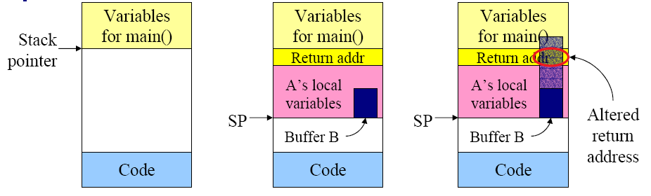
Stack Overflow Attack
1. Program starts running in main()
2. After procedure A() called
3. Buffer overflow alters the return address from A()
Can be garbage that causes program crash, or can be address of a malicious program, e.g., shellcode
Notes:
restrictedAccess() returns 0: the bounds check (if(x<buffer_size)) finished quickly and gets FALSE, so “return 0” is executed
To fixed the code, make sure that x is not in the cache with _mm_clflush(&larger_x) before calling restrictedAccess(larger_x), so the bounds check incurs a memory access and is slower

Slide 10
Stack Overflow Attack Example
int main(int argc, char *argv[]) {
int allow_login = 0;
char pwdstr[12];
char targetpwd[12] = "MyPwd123";
gets(pwdstr); //No bounds check!
if (strncmp(pwdstr,targetpwd, 12) == 0)
allow_login = 1;
if (allow_login == 0)
printf("Login request rejected");
else
printf("Login request allowed");
}
addr+4
argc (4B)
addr
argv (4B)
ret. addr(4B)
allow_login(4B)
pwdstr
(12B)
Input pwdstr larger than 12 B will cause stack overflow and may overwrite allow_login and/or return address.
If allow_login is overwritten to be 1, then login is successful.
If return address is overwritten to point to malicious code, then control flow jumps to it after main() finishes.
(This example shows attack on function main(), which is similar to attack on function A() shown earlier.)
targetpwd
(12B)
System stack grows downward (assuming a 32-bit CPU, so each word is 4 Bytes).
Notes:
Stack grows downwardsIf we enter a string longer than 12B, size of pwdstr[12], gets(pwdstr) will overflow into memory addresses of variable allow_login, so we can overwrite it to 1.
If we enter a string longer than 16B, we can overwrite the return address so it contains the address of some malicious code. When main() is exited, program counter will jump to that address and start execution.
(This example shows attack on main(), which is similar to attack on A() shown earlier.)

Slide 11
More Vulnerable Programs
In both (a) and (b), there is no bounds check on destination buffer size to[], hence the to[] array bound may be exceeded.
11
Notes:
With regard to programmers working on code for their own programs, the
discipline required to ensure that buffer overflows are not allowed to occur is a
subset of the various safe programming techniques we discuss in Chapter 11 . Most
specifically, it means a mindset that codes not just for success, or for the expected,
but is constantly aware of how things might go wrong, and coding for graceful failure
, always doing something sensible when the unexpected occurs. More specifically,
in the case of preventing buffer overflows, it means always ensuring that any code
that writes to a buffer must first check to ensure sufficient space is available. While
the preceding examples in this chapter have emphasized issues with standard library
routines such as gets(), and with the input and manipulation of string data, the
problem is not confined to these cases. It is quite possible to write explicit code to
move values in an unsafe manner. Figure 10.10a shows an example of an unsafe byte
copy function. This code copies len bytes out of the from array into the to array
starting at position pos and returning the end position. Unfortunately, this function
is given no information about the actual size of the destination buffer to and
hence is unable to ensure an overflow does not occur. In this case, the calling code
should to ensure that the value of size+len is not larger than the size of the to
array. This also illustrates that the input is not necessarily a string; it could just as
easily be binary data, just carelessly manipulated. Figure 10.10b shows an example of
an unsafe byte input function. It reads the length of binary data expected and then
reads that number of bytes into the destination buffer. Again the problem is that this
code is not given any information about the size of the buffer and hence is unable
to check for possible overflow. These examples emphasize both the need to always
verify the amount of space being used and the fact that problems can occur both
with plain C code, as well as from calling standard library routines. A further complexity
with C is caused by array and pointer notations being almost equivalent, but
with slightly different nuances in use. In particular, the use of pointer arithmetic and
subsequent dereferencing can result in access beyond the allocated variable space,
but in a less obvious manner. Considerable care is needed in coding such constructs.

Slide 12
Unsafe C Standard Library Routines
They should not be used before checking the total size of data being transferred.
Notes:
This shows that when looking for buffer overflows, all possible places where
externally sourced data are copied or merged have to be located. Note that these do
not even have to be in the code for a particular program, they can (and indeed do)
occur in library routines used by programs, including both standard libraries and
third-party application libraries. Thus, for both attacker and defender, the scope of
possible buffer overflow locations is very large. A list of some of the most common
unsafe standard C Library routines is given in Table 10.2 . These routines are all
suspect and should not be used without checking the total size of data being transferred
in advance, or better still by being replaced with safer alternatives.

Slide 13
shellcode
shellcode is code supplied by the attacker that creates a shell (command-line interpreter) that allows the attacker to execute any code he wants
Return address is overwritten to jump to shellcode, which is typically put on the stack by attacker.
On Linux: call execve (”/bin/sh”) to replace the current program code with the Bourne shell
On Windows: call system(”cmd.exe”) to run the command shell
13
Notes:
An essential component of many buffer overflow attacks is the transfer of execution
to code supplied by the attacker and often saved in the buffer being overflowed.
This code is known as shellcode , because traditionally its function was to transfer
control to a user command-line interpreter, or shell, which gave access to any program
available on the system with the privileges of the attacked program. On UNIX
systems this was often achieved by compiling the code for a call to the execve
(”/bin/sh”) system function, which replaces the current program code with that
of the Bourne shell (or whichever other shell the attacker preferred). On Windows
systems, it typically involved a call to the system(”command.exe”) function
(or ”cmd.exe” on older systems) to run the DOS Command shell. Shellcode then
is simply machine code, a series of binary values corresponding to the machine
instructions and data values that implement the attacker’s desired functionality.
This means shellcode is specific to a particular processor architecture, and indeed
usually to a specific operating system, as it needs to be able to run on the targeted
system and interact with its system functions. This is the major reason why buffer
overflow attacks are usually targeted at a specific piece of software running on a
specific operating system. Because shellcode is machine code, writing it traditionally
required a good understanding of the assembly language and operation of the
targeted system. Indeed many of the classic guides to writing shellcode, including
the original [LEVY96], assumed such knowledge.

Slide 14
Variants of Buffer Overflow Attacks
Target program can be:
Trusted system utility
Network service daemon
Commonly-used library code
Shellcode functions may be:
Set up a listening service to launch a remote shell when connected to
Create a reverse shell that connects back to the attacker
Use local exploits that establish a shell
Change firewall rules that block other attacks
Break out of a chroot jail (restricted execution environment), giving full access to the file system
14
Notes:
The targeted program need not be a trusted system utility. Another possible
target is a program providing a network service; that is, a network daemon. A common
approach for such programs is listening for connection requests from clients
and then spawning a child process to handle that request. The child process typically
has the network connection mapped to its standard input and output. This means
the child program’s code may use the same type of unsafe input or buffer copy code
as we’ve seen already. This was indeed the case with the stack overflow attack used
by the Morris Worm back in 1988. It targeted the use of gets() in the fingerd
daemon handling requests for the UNIX finger network service (which provided
information on the users on the system).
Yet another possible target is a program, or library code, which handles common
document formats (e.g., the library routines used to decode and display GIF or
JPEG images). In this case, the input is not from a terminal or network connection,
but from the file being decoded and displayed. If such code contains a buffer overflow,
it can be triggered as the file contents are read, with the details encoded in a
specially corrupted image. This attack file would be distributed via e-mail, instant
messaging, or as part of a Web page. Because the attacker is not directly interacting
with the targeted program and system, the shellcode would typically open a network
connection back to a system under the attacker’s control, to return information and
possibly receive additional commands to execute. All of this shows that buffer overflows
can be found in a wide variety of programs, processing a range of different
input, and with a variety of possible responses.
The preceding descriptions illustrate how simple shellcode can be developed
and deployed in a stack overflow attack. Apart from just spawning a commandline
(UNIX or DOS) shell, the attacker might want to create shellcode to perform
somewhat more complex operations, as indicated in the case just discussed. The
Metasploit Project site includes a range of functionality in the shellcode it can
generate, and the Packet Storm Web site includes a large collection of packaged
shellcode, including code that can
• Set up a listening service to launch a remote shell when connected to.
• Create a reverse shell that connects back to the hacker.
• Use local exploits that establish a shell or execve a process.
• Flush firewall rules (such as IPTables and IPChains) that currently block other
attacks.
• Break out of a chrooted (restricted execution) environment, giving full access
to the system.
Considerably greater detail on the process of writing shellcode for a variety of platforms,
with a range of possible results, can be found in [ANLE07].

Slide 15
Outline
Introduction
Stack overflows
Defending against buffer overflows
Compile-time defenses
Run-time defenses
Other forms of overflow attacks
Heap overflows
Global data area overflows
Integer overflows
Notes:
Stack overflows
Buffer overflow basics
Stack buffer overflows
Shellcode
Defending against buffer overflows
Compile-time defenses
Run-time defenses
Other forms of overflow attacks
Replacement stack frame
Return to system call
Heap overflows
Global data area overflows
Other types of overflows

Slide 16
Buffer Overflow Defenses
Compile-time defenses: harden programs to resist attacks in new programs
Choose a high-level language (e.g., Java), encouraging safe coding standards, using safe standard libraries, or including additional code to detect stack frame corruption
Run-time defenses: detect and thwart attacks in existing programs
Executable Address Space Protection, Address Space Layout Randomization, Guard Pages.
16
Notes:
We have seen that finding and exploiting a stack buffer overflow is not that difficult.
The large number of exploits over the previous couple of decades clearly
illustrates this. There is consequently a need to defend systems against such attacks
by either preventing them, or at least detecting and aborting such attacks. This section
discusses possible approaches to implementing such protections. These can be
broadly classified into two categories:
• Compile-time defenses, which aim to harden programs to resist attacks in new
programs
• Run-time defenses, which aim to detect and abort attacks in existing
programs
While suitable defenses have been known for a couple of decades, the very large
existing base of vulnerable software and systems hinders their deployment. Hence
the interest in run-time defenses, which can be deployed as operating systems and
updates and can provide some protection for existing vulnerable programs. Most of
these techniques are mentioned in [LHCEE03].
Compile-time defenses aim to prevent or detect buffer overflows by instrumenting
programs when they are compiled. The possibilities for doing this range from
choosing a high-level language that does not permit buffer overflows, to encouraging
safe coding standards, using safe standard libraries, or including additional code to
detect corruption of the stack frame.

Slide 17
Compile-Time Defenses: Programming Languages
Low-level languages such as C allow direct access to memory addresses.
Are vulnerable to buffer overflow
Large legacy code base that is unsafe
Modern high-level languages (Java, C#...）have a strong notion of type and valid operations
Compiler enforces array bounds checks and permissible operations on variables
Incur more runtime overhead; not good for writing low-level code like device drivers
17
Notes:
Before exploring buffer overflows further, it is worth considering just how the
potential for their occurrence developed and why programs are not necessarily protected
from such errors. To understand this, we need to briefly consider the history
of programming languages and the fundamental operation of computer systems.
At the basic machine level, all of the data manipulated by machine instructions
executed by the computer processor are stored in either the processor’s registers
or in memory. The data are simply arrays of bytes. Their interpretation is entirely
determined by the function of the instructions accessing them. Some instructions
will treat the bytes are representing integer values, others as addresses of data or
instructions, and others as arrays of characters. There is nothing intrinsic in the registers
or memory that indicates that some locations have an interpretation different
from others. Thus, the responsibility is placed on the assembly language programmer
to ensure that the correct interpretation is placed on any saved data value. The
use of assembly (and hence machine) language programs gives the greatest access
to the resources of the computer system, but at the highest cost and responsibility in
coding effort for the programmer.
At the other end of the abstraction spectrum, modern high-level programming
languages like Java, ADA, Python, and many others have a very strong notion of
the type of variables and what constitutes permissible operations on them. Such
languages do not suffer from buffer overflows because they do not permit more
data to be saved into a buffer than it has space for. The higher levels of abstraction,
and safe usage features of these languages, mean programmers can focus more
on solving the problem at hand and less on managing details of interactions with
variables. But this flexibility and safety comes at a cost in resource use, both at
compile time, and in additional code that must executed at run time to impose
checks such as that on buffer limits. The distance from the underlying machine
language and architecture also means that access to some instructions and hardware
resources is lost. This limits their usefulness in writing code, such as device drivers,
that must interact with such resources.
In between these extremes are languages such as C and its derivatives, which
have many modern high-level control structures and data type abstractions but
which still provide the ability to access and manipulate memory data directly. The C
programming language was designed by Dennis Ritchie, at Bell Laboratories, in the
early 1970s. It was used very early to write the UNIX operating system and many of
the applications that run on it. Its continued success was due to its ability to access
low-level machine resources while still having the expressiveness of high-level control
and data structures and because it was fairly easily ported to a wide range of
processor architectures. It is worth noting that UNIX was one of the earliest operating
systems written in a high-level language. Up until then (and indeed in some
cases for many years after), operating systems were typically written in assembly
language, which limited them to a specific processor architecture. Unfortunately,
the ability to access low-level machine resources means that the language is susceptible
to inappropriate use of memory contents. This was aggravated by the fact that
many of the common and widely used library functions, especially those relating to
input and processing of strings, failed to perform checks on the size of the buffers
being used. Because these functions were common and widely used, and because
UNIX and derivative operating systems like Linux are widely deployed, this means
there is a large legacy body of code using these unsafe functions, which are thus
potentially vulnerable to buffer overflows. We return to this issue when we discuss
countermeasures for managing buffer overflows.

Slide 18
Compile-Time Defenses: Safe Coding Techniques
C was designed with more emphasis on space efficiency and performance than on type safety
Programmers must take responsibility for ensuring safe use of all data structures and variables.
For security hardening, programmers need to inspect the code and rewrite any unsafe code
Notes:
If languages such as C are being used, then
programmers need to be aware that their ability to manipulate pointer addresses
and access memory directly comes at a cost. It has been noted that C was designed
as a systems programming language, running on systems that were vastly smaller
and more constrained than we now use. This meant C’s designers placed much
more emphasis on space efficiency and performance considerations than on type
safety. They assumed that programmers would exercise due care in writing code
using these languages and take responsibility for ensuring the safe use of all data
structures and variables.
Unfortunately, as several decades of experience has shown, this has not been
the case. This may be seen in large legacy body of potentially unsafe code in the
Linux, UNIX, and Windows operating systems and applications, some of which are
potentially vulnerable to buffer overflows.
In order to harden these systems, the programmer needs to inspect the code
and rewrite any unsafe coding constructs in a safe manner. Given the rapid uptake
of buffer overflow exploits, this process has begun in some cases. A good example
is the OpenBSD project, which produces a free, multiplatform 4.4BSD-based
UNIX-like operating system. Among other technology changes, programmers
have undertaken an extensive audit of the existing code base, including the operating
system, standard libraries, and common utilities. This has resulted in what
is widely regarded as one of the safest operating systems in widespread use. The
OpenBSD project claims as of mid-2006 that there has been only one remote hole
discovered in the default install in more than eight years. This is a clearly enviable
record. Microsoft programmers have also undertaken a major project in reviewing
their code base, partly in response to continuing bad publicity over the number of
vulnerabilities, including many buffer overflow issues, that have been found in their
operating systems and applications code. This has clearly been a difficult process,
though they claim that their more recent Vista and Windows operating systems
benefit greatly from this process.

Slide 19
Compile-Time Defenses: Language Extensions/Safe Libraries
The compiler can be augmented to automatically insert range checks on references to arrays and pointers. While easy for statically allocated arrays, dynamically memory allocation is harder as size information is not available at compile time
Requires an extension to the semantics of a pointer to include bounds information and the use of library routines to ensure these values are set correctly
Programs and libraries need to be recompiled
Likely to have problems with third-party applications
Replace unsafe standard C library routines with safe variants
Example: libsafe adds bounds checks to vulnerable libc functions
19
Notes:
Given the problems
that can occur in C with unsafe array and pointer references, there have been a
number of proposals to augment compilers to automatically insert range checks
on such references. While this is fairly easy for statically allocated arrays, handling
dynamically allocated memory is more problematic, because the size information is
not available at compile time. Handling this requires an extension to the semantics
of a pointer to include bounds information and the use of library routines to ensure
these values are set correctly. Several such approaches are listed in [LHEE03].
However, there is generally a performance penalty with the use of such techniques
that may or may not be acceptable. These techniques also require all programs
and libraries that require these safety features to be recompiled with the modified
compiler. While this can be feasible for a new release of an operating system and its
associated utilities, there will still likely be problems with third-party applications.
A common concern with C comes from the use of unsafe standard library routines,
especially some of the string manipulation routines. One approach to improving
the safety of systems has been to replace these with safer variants. This can
include the provision of new functions, such as strlcpy() in the BSD family of
systems, including OpenBSD. Using these requires rewriting the source to conform
to the new safer semantics. Alternatively, it involves replacement of the standard
string library with a safer variant. Libsafe is a well-known example of this. It implements
the standard semantics but includes additional checks to ensure that the copy
operations do not extend beyond the local variable space in the stack frame. So
while it cannot prevent corruption of adjacent local variables, it can prevent any
modification of the old stack frame and return address values, and thus prevent the
classic stack buffer overflow types of attack we examined previously. This library
is implemented as a dynamic library, arranged to load before the existing standard
libraries, and can thus provide protection for existing programs without requiring
them to be recompiled, provided they dynamically access the standard library routines
(as most programs do). The modified library code has been found to typically
be at least as efficient as the standard libraries, and thus its use is an easy way of
protecting existing programs against some forms of buffer overflow attacks.

Slide 20
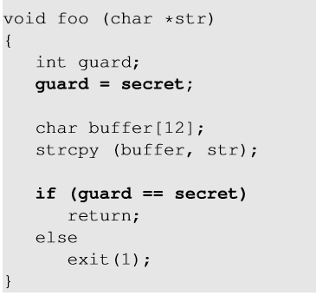
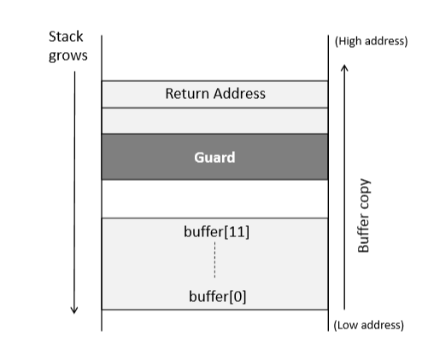
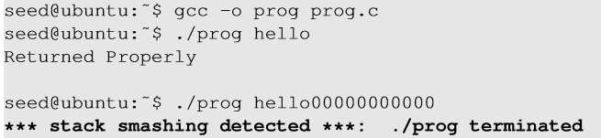
Compile-Time Defenses: Stack Guard
Compiler stores a random secret value (secret) in a memory location (in the heap, not on stack), which is assigned to a local variable of the function (guard) which gets stored in the stack.
Before jumping to the return address, check if the value of the local variable is changed. If yes, buffer overflow has taken place and the program exits without returning.
20
Notes:
Added function entry code writes a random canary value below the old frame pointer address, before the allocation of space for local variables
Overwriting return address will always overwrite the canary value first
Added function exit code checks that the canary value has not changed
Insert function entry and exit code to check stack for signs of corruption
Insert additional function entry and exit code
Stackguard
Before using the return address,
check if the canary value on stack is the
same as value stored in a register
An effective method for protecting programs
against classic stack overflow attacks is to instrument the function entry and exit
code to setup and then check its stack frame for any evidence of corruption. If
any modification is found, the program is aborted rather than allowing the attack
to proceed. There are several approaches to providing this protection, which we
discuss next.
Stackguard is one of the best known protection mechanisms. It is a GCC
compiler extension that inserts additional function entry and exit code. The added
function entry code writes a canary value below the old frame pointer address,
before the allocation of space for local variables. The added function exit code checks
that the canary value has not changed before continuing with the usual function
exit operations of restoring the old frame pointer and transferring control back to
the return address. Any attempt at a classic stack buffer overflow would have to
alter this value in order to change the old frame pointer and return addresses, and
would thus be detected, resulting in the program being aborted. For this defense to
function successfully, it is critical that the canary value be unpredictable and should
be different on different systems. If this were not the case, the attacker would simply
ensure the shellcode included the correct canary value in the required location.
Typically, a random value is chosen as the canary value on process creation and
saved as part of the processes state. The code added to the function entry and exit
then use this value.
There are some issues with using this approach. First, it requires that all programs
needing protection be recompiled. Second, because the structure of the stack
frame has changed, it can cause problems with programs, such as debuggers, which
analyze stack frames. However, the canary technique has been used to recompile an
entire Linux distribution and provide it with a high level of resistance to stack overflow
attacks. Similar functionality is available for Windows programs by compiling
them using Microsoft’s /GS Visual C++ compiler option.
Another variant to protect the stack frame is used by Stackshield and Return
Address Defender (RAD). These are also GCC extensions that include additional
function entry and exit code. These extensions do not alter the structure of the stack
frame. Instead, on function entry the added code writes a copy of the return address
to a safe region of memory that would be very difficult to corrupt. On function exit
the added code checks the return address in the stack frame against the saved copy
and, if any change is found, aborts the program. Because the format of the stack
frame is unchanged, these extensions are compatible with unmodified debuggers.
Again, programs must be recompiled to take advantage of these extensions.

Slide 21
Run-Time Defenses: Executable Address Space Protection
Use virtual memory support to make some regions of memory non-executable
Requires support from memory management unit (MMU)
NX bit (No-eXecute) in modern CPUs
Put in page table; says “don’t execute code in this page”
21
Notes:
Issues
Some programs need to place executable code on the stack, e.g., Java Just-In-Time (JIT) compilers
As has been noted, most of the compile-time approaches require recompilation of
existing programs. Hence there is interest in run-time defenses that can be deployed
as operating systems updates to provide some protection for existing vulnerable
programs. These defenses involve changes to the memory management of the virtual
address space of processes. These changes act to either alter the properties of
regions of memory, or to make predicting the location of targeted buffers sufficiently
difficult to thwart many types of attacks.
Many of the buffer overflow attacks,
such as the stack overflow examples in this chapter, involve copying machine code
into the targeted buffer and then transferring execution to it. A possible defense is
to block the execution of code on the stack, on the assumption that executable code
should only be found elsewhere in the processes address space.
To support this feature efficiently requires support from the processor’s memory
management unit (MMU) to tag pages of virtual memory as being nonexecutable.
Some processors, such as the SPARC used by Solaris, have had support for this
for some time. Enabling its use in Solaris requires a simple kernel parameter change.
Other processors, such as the x86 family, have not had this support until recently,
with the relatively recent addition of the no-execute bit in its MMU. Extensions have
been made available to Linux, BSD, and other UNIX-style systems to support the
use of this feature. Some indeed are also capable of protecting the heap as well as the
stack, which is also is the target of attacks, as we discuss in Section 10.3 . Support for
enabling no-execute protection is also included in Windows systems since XP SP2.
Making the stack (and heap) nonexecutable provides a high degree of protection
against many types of buffer overflow attacks for existing programs; hence
the inclusion of this practice is standard in a number of recent operating systems
releases. However, one issue is support for programs that do need to place executable
code on the stack. This can occur, for example, in just-in-time compilers, such
as is used in the Java Runtime system. Executable code on the stack is also used to
implement nested functions in C (a GCC extension) and also Linux signal handlers.
Special provisions are needed to support these requirements. Nonetheless, this is
regarded as one of the best methods for protecting existing programs and hardening
systems against some attacks.

Slide 22
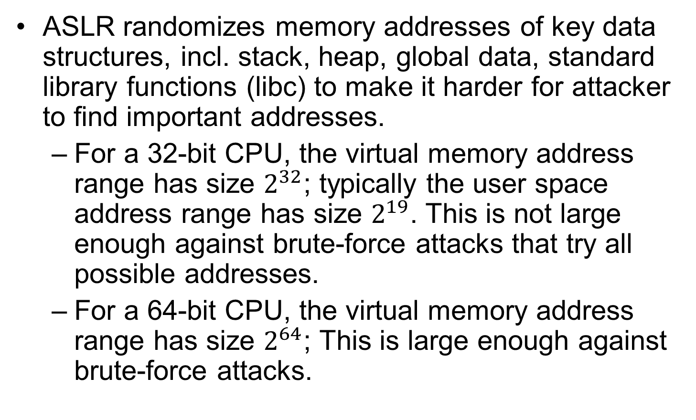
Run-Time Defenses: Address Space Layout Randomization (ASLR)
ASLR randomizes memory addresses of key data structures, incl. stack, heap, global data, standard library functions (libc) to make it harder for attacker to find important addresses.
For a 32-bit CPU, the virtual memory address range has size $2^{32}$; typically the user space address range has size $2^{19}$. This is not large enough against brute-force attacks that try all possible addresses.
For a 64-bit CPU, the virtual memory address range has size $2^{64}$; This is large enough against brute-force attacks.
22
Notes:
Another run-time technique that can be used
to thwart attacks involves manipulation of the location of key data structures in a
processes address space. In particular, recall that in order to implement the classic
stack overflow attack, the attacker needs to be able to predict the approximate
location of the targeted buffer. The attacker uses this predicted address to determine
a suitable return address to use in the attack to transfer control to the shellcode. One
technique to greatly increase the difficulty of this prediction is to change the address
at which the stack is located in a random manner for each process. The range of
addresses available on modern processors is large (32 bits), and most programs only
need a small fraction of that. Therefore, moving the stack memory region around by
a megabyte or so has minimal impact on most programs but makes predicting the
targeted buffer’s address almost impossible. This amount of variation is also much
larger than the size of most vulnerable buffers, so there is no chance of having a large
enough NOP sled to handle this range of addresses. Again this provides a degree of
protection for existing programs, and while it cannot stop the attack proceeding, the
program will almost certainly abort due to an invalid memory reference.
Related to this approach is the use of random dynamic memory allocation (for
malloc() and related library routines). As we discuss in Section 10.3 , there is a
class of heap buffer overflow attacks that exploit the expected proximity of successive
memory allocations, or indeed the arrangement of the heap management data
structures. Randomizing the allocation of memory on the heap makes the possibility
of predicting the address of targeted buffers extremely difficult, thus thwarting
the successful execution of some heap overflow attacks.
Another target of attack is the location of standard library routines. In an
attempt to bypass protections such as nonexecutable stacks, some buffer overflow
variants exploit existing code in standard libraries. These are typically loaded at
the same address by the same program. To counter this form of attack, we can use
a security extension that randomizes the order of loading standard libraries by a
program and their virtual memory address locations. This makes the address of any
specific function sufficiently unpredictable as to render the chance of a given attack
correctly predicting its address, very low.
The OpenBSD system includes versions of all of these extensions in its technological
support for a secure system.

Slide 23
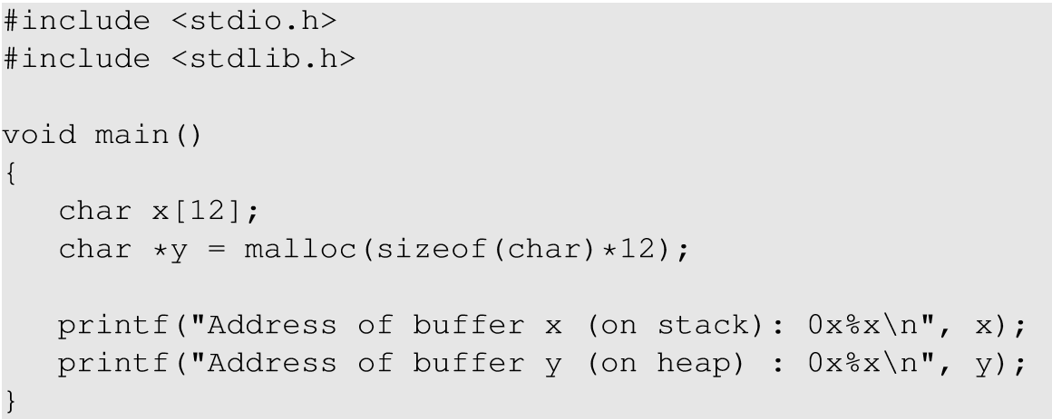
ASLR Example
Array x[12] is statically allocated; hence it is on the stack;
Array y[12] is allocated dynamically with malloc(), hence it is on the heap.

Slide 24
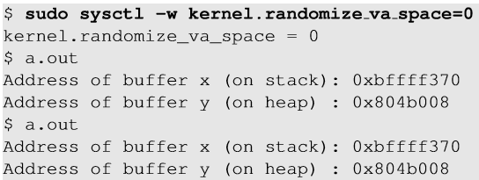
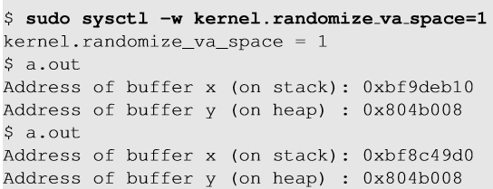
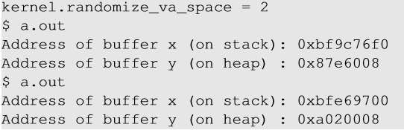
When set to 0, address space is not randomized.
When set to 1, only stack memory address is randomized.
When set to 2, both stack and heap memory addresses are randomized.

Slide 25
Run-Time Defenses: Guard Pages
Place guard pages between critical regions of memory
Flagged in MMU as illegal addresses
Any attempted access aborts process
Further extension places guard pages between multiple stack frames and heap buffers
25
Notes:
A final runtime technique that can be used places guard pages
between critical regions of memory in a processes address space. Again, this
exploits the fact that a process has much more virtual memory available than
it typically needs. Gaps are placed between the ranges of addresses used for each
of the components of the address space, as was illustrated in Figure 10.4 . These
gaps, or guard pages, are flagged in the MMU as illegal addresses, and any attempt
to access them results in the process being aborted. This can prevent buffer
overflow attacks, typically of global data, which attempt to overwrite adjacent
regions in the processes address space, such as the global offset table, as we discuss
in Section 10.3 .
A further extension places guard pages between stack frames or between different
allocations on the heap. This can provide further protection against stack and
heap over flow attacks, but at cost in execution time supporting the large number of
page mappings necessary.

Slide 26
Outline
Introduction
Stack overflows
Defending against buffer overflows
Compile-time defenses
Run-time defenses
Other forms of overflow attacks
Heap overflows
Global data area overflows
Integer overflows
Notes:
Stack overflows
Buffer overflow basics
Stack buffer overflows
Shellcode
Defending against buffer overflows
Compile-time defenses
Run-time defenses
Other forms of overflow attacks
Replacement stack frame
Return to system call
Heap overflows
Global data area overflows
Other types of overflows

Slide 27
Heap Overflow
Dynamic memory allocation on the heap
Malloc() in C, and new() in C++
No function return address on the heap
But attacker may overwrite function pointers to point to shellcode
Defenses
Making the heap non-executable
Randomizing the allocation of memory on the heap
Stack
Large Gap
Function Pointer
char* p = malloc (256);
memset (p, ‘A’, 1024);
Heap
27
Notes:
With growing awareness of problems with buffer overflows on the stack and the
development of defenses against them, attackers have turned their attention to
exploiting overflows in buffers located elsewhere in the process address space. One
possible target is a buffer located in memory dynamically allocated from the heap .
The heap is typically located above the program code and global data and grows up
in memory (while the stack grows down toward it). Memory is requested from the
heap by programs for use in dynamic data structures, such as linked lists of records.
If such a record contains a buffer vulnerable to overflow, the memory following it
can be corrupted. Unlike the stack, there will not be return addresses here to easily
cause a transfer of control. However, if the allocated space includes a pointer to a
function, which the code then subsequently calls, an attacker can arrange for this
address to be modified to point to shellcode in the overwritten buffer. Typically,
this might occur when a program uses a list of records to hold chunks of data while
processing input/output or decoding a compressed image or video file. As well as
holding the current chunk of data, this record may contain a pointer to the function
processing this class of input (thus allowing different categories of data chunks to be
processed by the one generic function). Such code is used and has been successfully
attacked.

Slide 28
Global Data Overflow
Can attack buffer located in global data area
If buffer overflow occurs, data may overflow global buffer and change adjacent memory locations, including perhaps one with a function pointer.
Defenses
Making the global data area non-executable,
Arranging function pointers to be located below any other types of data
Using guard pages between global data area and other parts
28
Notes:
A final category of buffer overflows we consider involves buffers located in the
program’s global (or static) data area. Figure 10.4 showed that this is loaded from
the program file and located in memory above the program code. Again, if unsafe
buffer operations are used, data may overflow a global buffer and change adjacent
memory locations, including perhaps one with a function pointer, which is then
subsequently called.
Defenses against such attacks include making the global data area non-executable,
arranging function pointers to be located below any other types of data, and
using guard pages between the global data area and any other management areas.

Slide 29
Integer Overflow
Integer overflow occurs value assigned to an integer exceeds its maximum size.
Feed a program large params to cause integer overflow on variable, then program may allocate a too-small buffer based on the variable’s value, hence enabling buffer overflow attack
This convert a dataflow attack into a control flow attack
int f() {!
unsigned short x = 65535;!
x++; // overflows to become 0!
printf(“%d\n”,x); // memory safe!
char *p = malloc(x); // size-0 buffer!!
p[1] = ‘a’; // violation!
}
Notes:
If arithmetic results exceed maximum integer size, computer stores an incorrect value

